Slide 1
Epilepsy
Eva Feketeová
Dept. of Neurology, Mediacal Faculty UPJŠ

Slide 2
Epileptic seizure: acute
Epilepsy
Status epilepticus
1 YEAR

Slide 3
Epileptic seizure
Seizure- symptom, represents the clinical manifestation of an abnormal and excessive synchronized discharge (uncontrolled electrical activity) of a set of cortical nn. in the brain
Mechanisms: Nerve cells transmit signals to and from the brain in two ways by
(1) altering the concentrations of salts (sodium, potassium, calcium) within the cell
(2) releasing chemicals called neurotransmitters (gamma aminobutyric acid). The change in salt concentration conducts the impulse from one end of the nerve cell to the other.
Notes:
symptom, represents the clinical manifestation of an abnormal and excessive synchronized discharge of a set of cortical nn. in the brain

Slide 4
Epileptic seizure
ACUTE/SYMPTOMATIC (up to 7-14 days after the insult)
  Stroke
  Trauma
UNPROVOKED/REFLEX
  Epilepsy

Slide 5
Epileptic seizure
Focal Seizures
The site of origin is a localized or discreet area in one hemisphere of the brain.
Generalized Seizures
At the onset, seizure activity occurs simultaneously in large areas of the brain, often in both hemispheres.

Slide 6
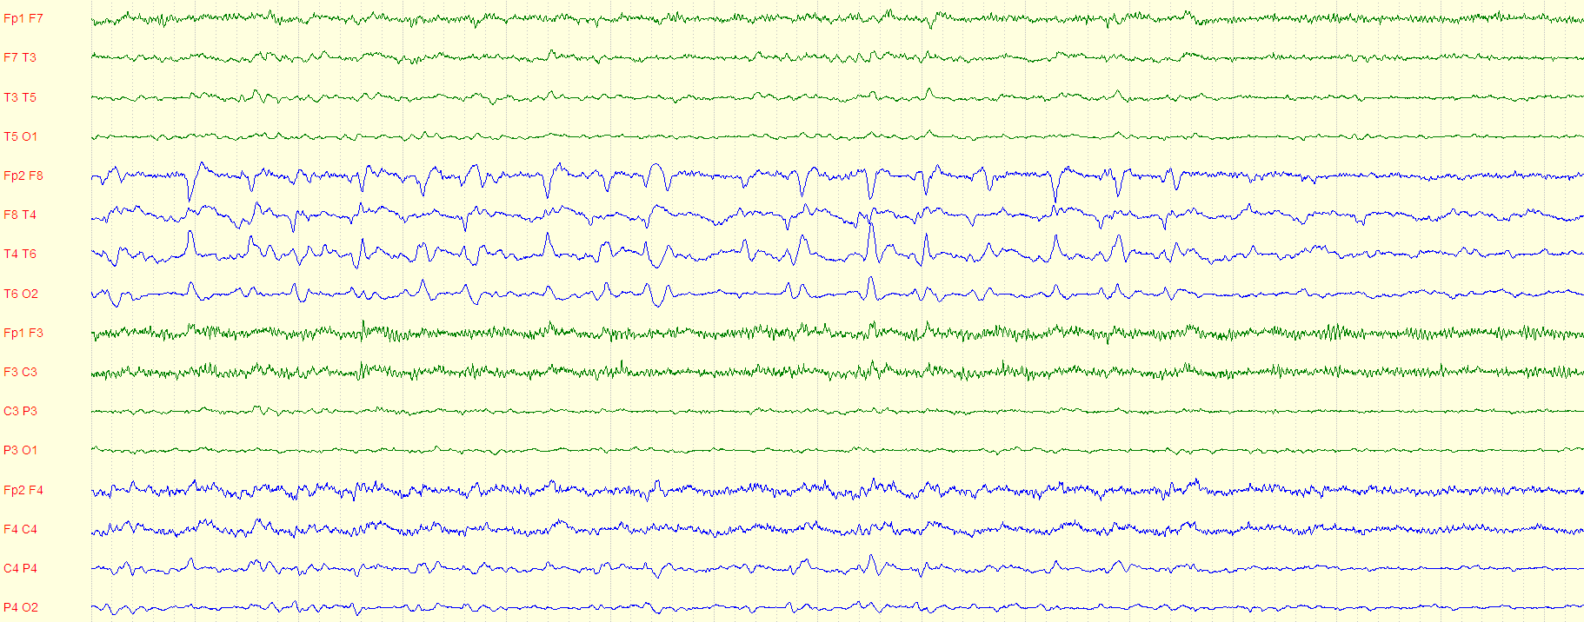
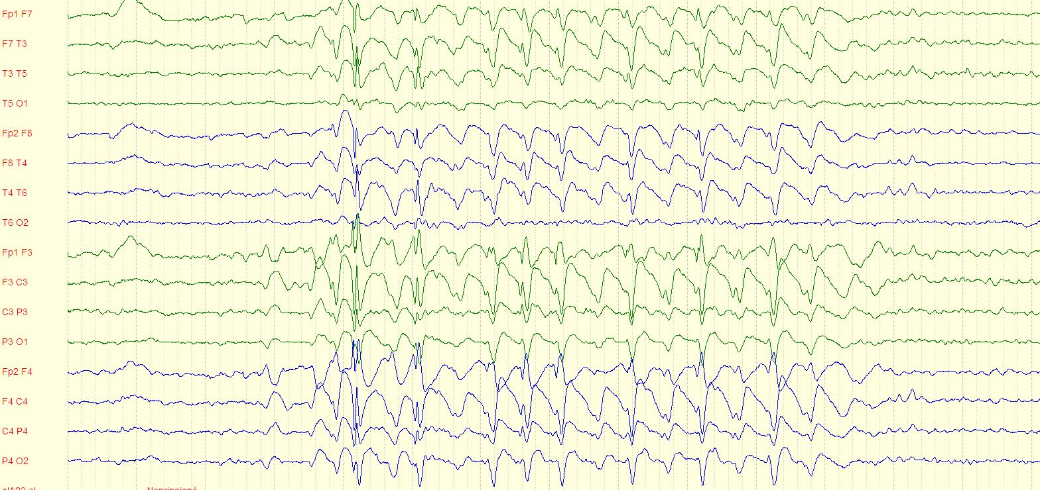
FOCAL
Epileptic discharge
(TLE l. dx.)
GENERALIZED
epileptic discharge
(Abcence s.)

Slide 7
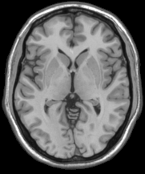
Generalized seizures
Notes:
Here is a diagram that shows a conceptual network for generalized seizures involving the corticothalamic circuitry. Theoretically a generalized seizure could start at different points in the network and engage bilaterally distributed networks. Thus a seizure could start frontally or even parietally.The key point is that a generalized seizure can start from a focal point.
7

Slide 8
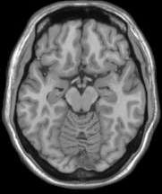
Focal seizures
Notes:
8

Slide 9
INTERNATIONAL CLASSIFICATION OF SEIZURES 1981
  Partial Seizures (start in one place)
      Simple (no loss of consciousness of memory)
  Sensory
  Motor
  Sensory-Motor
  Psychic (abnormal thoughts or perceptions)
  Autonomic (heat, nausea, flushing, etc.)
  Complex (consciousness or memory impaired)
  With or without aura (warning)
  With or without automatisms
  Secondarily generalized
  Generalized Seizures (apparent start over wide areas of brain)
  Absence (petit mal)
  Tonic-clonic (grand mal)
  Atonic (drop seizures)
  Myoclonic
  Other
  Unclassifiable seizures
NOT used anymore
Dreifuss et al. Proposal for revised clinical and electroencephalographic classification of epileptic seizures. From the Commission on Classification and Terminology of the International League Against Epilepsy. Epilepsia. 1981;22:489-501.

Slide 10
ILAE 2017 Classification of Seizure Types Basic Version ¹
Focal Onset
Generalized Onset
Unknown Onset
Aware
Impaired
Awareness
Motor
Tonic-clonic
Other motor
Non-Motor (Absence)
Motor
Tonic-clonic
Other motor
Non-Motor
Motor
Non-Motor
Unclassified ²
focal to bilateral tonic-clonic
¹ Definitions, other seizure types and descriptors are listed in the accompanying paper & glossary of terms
² Due to inadequate information or inability to place in other categories
From Fisher et al. Instruction manual for the ILAE 2017 operational classification of seizure types. Epilepsia doi: 10.1111/epi.13671

Slide 11
ILAE 2017 Classification of Seizure Types Expanded Version¹
Focal Onset
Generalized Onset
Unknown Onset
Aware
Impaired
Awareness
Motor
tonic-clonic
clonic
tonic
myoclonic
myoclonic-tonic-clonic
myoclonic-atonic
atonic
epileptic spasms²
Non-Motor (absence)
typical
atypical
myoclonic
eyelid myoclonia
Motor
tonic-clonic
epileptic spasms
Non-Motor
behavior arrest
Motor Onset
automatisms
atonic²
clonic
epileptic spasms²
hyperkinetic
myoclonic
tonic
Non-Motor Onset
autonomic
behavior arrest
cognitive
emotional
sensory
Unclassified³
¹ Definitions, other seizure types and descriptors are listed in the
accompanying paper and glossary of terms.
² These could be focal or generalized, with or without alteration of awareness
³ Due to inadequate information or inability to place in other categories
focal to bilateral tonic-clonic
From Fisher et al. Instruction manual for the ILAE 2017 operational classification of seizure types. Epilepsia doi: 10.1111/epi.13671

Slide 12

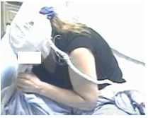
Loss (or Impairment) of Consciousness
Two types of seizures with loss of consciousness

Slide 13
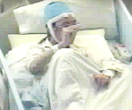
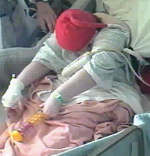
Some Seizure Onsets can be Focal or Generalized
Focal Onset
Generalized Onset
atonic
atonic
clonic
clonic
epileptic spasms
epileptic spasms
myoclonic
myoclonic
tonic
tonic
tonic-clonic
tonic-clonic

Slide 14
Epileptic seizure
Epilepsy
Status epilepticus
1 YEAR

Slide 15
Epilepsy
from Greek word epilambanein, meaning „to seize“ or „to attack“
Epilepsy –
At least two unprovoked (or reflex) seizures occurring more than 24 hours apart
One unprovoked (or reflex) seizure and a probability of further seizures similar to the general recurrence risk (at least 60%) after two unprovoked seizures, occurring over the next 10 years
Epilepsy is considered to be resolved for individuals who had an age-dependent self-limited epilepsy syndrome but who are now past the applicable age, or for those who have remained seizure-free for the last 10 years, with no seizure medication for the last 5 years.
Prevalence: 1%

Slide 16
Epilepsy according to the seizure type
Focal epilepsies
(those with partial onset epileptic seizures)
Generalized epilepsies
(those with generalized onset epileptic seizures)

Slide 17
Co-morbidities
Seizure types
Etiology
Focal
onset
Generalized onset
Unknown onset
Structural
Genetic
Epilepsy types
Infectious
Focal
Generalized
Combined
Generalized
& Focal
Unknown
Focal
Metabolic
Immune
Unknown
Epilepsy Syndromes

Slide 18
Seizure types
Etiology
Focal
onset
Generalized onset
Unknown onset
Structural
Genetic
Tuberous Sclerosis
Infectious
Metabolic
Immune
GLUT1 deficiency
Unknown

Slide 19
Old term
‘Idiopathic Generalized Epilepsies’
Idiopathic Generalized Epilepsies
Childhood
Absence
Epilepsy
Juvenile
Absence
Epilepsy
Juvenile
Myoclonic
Epilepsy
Generalized
Tonic-Clonic
Seizures Alone

Slide 20
Genetic versus idiopathic
‘Idiopathic’ = presumed hereditary predisposition
Genetic ≠ inherited
  Importance of de novo mutations in both
  mild and severe epilepsies
Critical problem of stigma in some parts of the world

Slide 21
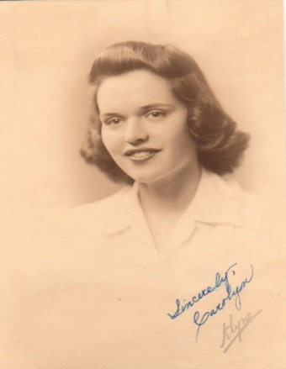
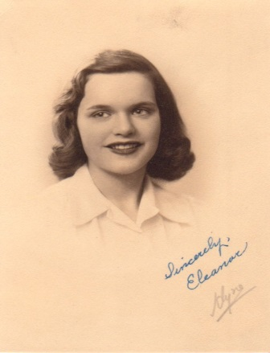
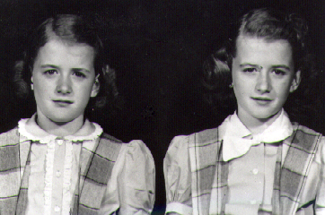
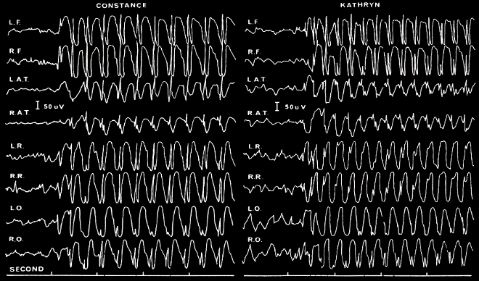
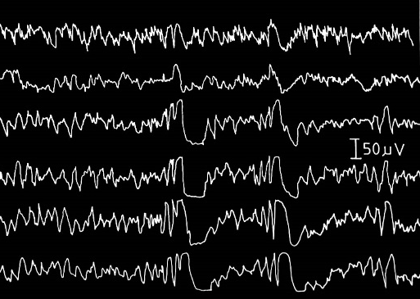
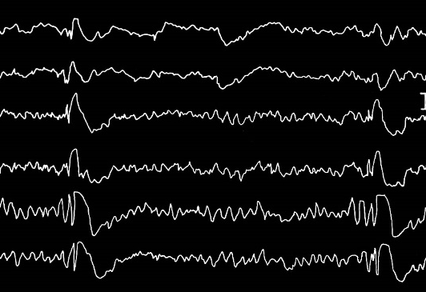
Genetic ≠ Gene testing
  Usually the mutation is not known
  Access to molecular genetic testing not necessary
  Diagnosed on clinical research eg. twin, family studies
JME pair; Lennox 1941
CAE pair; Lennox 1950

Slide 22
Epilepsy according to the natural evolution
Epilepsy controlled by treatment
  complete seizure control unther the treatment
Pharmacoresistant epilepsy
  the failure to achieve seizure control with the first or second trial of an anticonvulsant medication given at the appropriate daily dosage

Slide 23
  Benign:Malignant Epilepsies
  Self-limited/Pharmacoresponsive:
  Developmental /Epileptic encephalopathies
Many epilepsies are not benign
  Childhood absence epilepsy – psychosocial impact
  Bening epilepsy with centrotemporal spikes – learning concerns
Replaced by terms:
  Self-limited
  Pharmacoresponsive
No longer use
  Malignant
  Catastrophic

Slide 24
Developmental and/or Epileptic encephalopathies
Epileptic activity itself
contributes to severe cognitive and behavioral impairment above and beyond that expected from the underlying pathology and that these can worsen over time
Berg et al 2010

Slide 25
Developmental and/or Epileptic Encephalopathy
For many encephalopathies, there is a developmental component independent of the epileptic encephalopathy
Developmental delay may precede seizure onset
Co-morbidities
eg. cerebral palsy, autism spectrum disorder, intellectual disability
Outcome poor even though seizures stop
eg. KCNQ2, STXBP1 encephalopathies

Slide 26
Developmental and/or Epileptic Encephalopathy
Developmental encephalopathy
  May begin in utero
  Post birth
Epileptic encephalopathy
  Can occur at any age
  May have remediable component – right vs wrong AED
Move towards GENE encephalopathy
  eg. CDKL5 encephalopathy, SCN2A encephalopathy

Slide 27
Examples of the most frequent Epilepsies

Slide 28
Benign epilepsy with centrotemporal spikes
(idiopathic focal epilepsy)
  Childhood (3-13yy)
  Predominance of nocturnal seizures- focal onset epileptic seizues with Impaired awareness, less frequently evolving into bilateral tonic-clonic ES
  EEG: Centrotemporal spikes
  Nearly all (95%) patients uotgrow the disorder

Slide 29
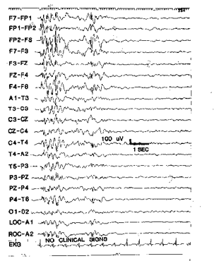
Juvenile myoclonic epilepsy (JME)
GENERALIZED EPILEPSY
Different types of generalized onset seizures
Myoclonic jerks on awakening
in the morning
(„patient may spill or
drop things, seldom falls“)
Tonic clonic seizures
Absence seizures
Inherited condition
EEG: Multiple spike and wave
complexes precipitated
by photic stimulation

Slide 30
Lennox-Gastaut syndrome
-devastating disorder in children
Mix types of seizures
Mental retardation= epileptic encepahlopathy
EEG: slow (less than 2,5Hz) spike and wave patterns

Slide 31
Mesial temporal lobe epilepsy
Hippocampal sclerosis- the most common pathology
Temporal lobe epilepsy- focal onset epileptic seizues:
  Vegetative auras or affective symptoms (fear)
  Automatims- oroalimentary, gestural or reactive automatisms
  Asymetric posturing with impairment awareness
  Rare evolving into bilateral tonic clonic ES
Onset: before puberty

Slide 32
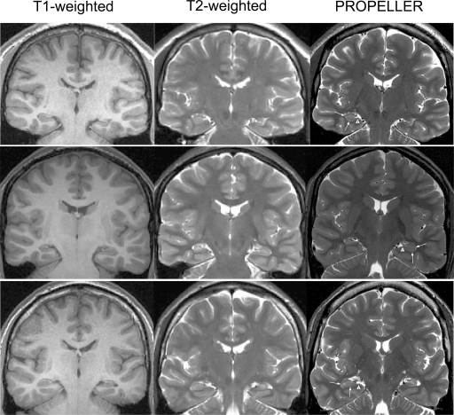
Mesial temporal lobe epilepsy

Slide 33
Epilepsy- diagnose
complete patient history (details of birth, childhood, family history, and medication regimen; medical history, history of drug and alcohol use)
A detailed description of the seizures (important to distinguish seizure types)
Neurological examination
Electroencephalogram (EEG)
EEG is a diagnostic test used to investigate a seizure disorder. It identifies abnormal electrical activity in the brain, provides information about the type of seizure disorder, and locates the area of seizure focus.
Neuroimaging
Magnetic resonance imaging (MRI scan) or computed tomography (CT scan or CAT scan) are performed when a lesion or other structural cause, such as stroke or tumor, is suspected.

Slide 34
Epilepsy- differencial diagnose
Neurological
  Transient ischaemic attack
  Migraine
  Sleep disorders
    Narcolepsy with cataplexy
    REM behaviour disorder
    somnambulism
Cardiac
  Vasovagal syncope
  Arrhythmias
  Hypotension
  Reflex anoxic seizure
Endocrine/metabolic
  Changes of blood glucouse, ions
Psychological
  Non-epileptic psychogenic seizures

Slide 35
Epilepsy treatment
Medication- depends on seizure type
  Focal seizures- LEVETIRACETAM, LAMOTRIGINE (carbamazepine)
  Generalized- VALPROATE/ LEVETIRACETAM
  New generation: topiramate, gabapentin, pregabalin, zonisamide, perampanel, brivaracetam, lacosamide
Other- Ketogenic Diet , ...
Surgery
  VNS
  Resection of the lesion
  Calosothomy...

Slide 36
Epileptic seizure
Epilepsy
Status epilepticus
1 YEAR

Slide 37
EMERGENCY IN EPILEPSY
Status epilepticus = seizures lasting for 5 minutes or more or recurrent seizures without recovery of consciousness to baseline between the attacks.
Refractory SE is defined as SE persisting despite sufficient dose of benzodiazepines and at least one antiepileptic drug, irrespective of time.
Super refractory SE = SE that continues for 24 hours or more after the use of anesthetic therapy, including cases that recur on weaning of the anesthestic agent.
Look for infection, trauma, consider autoimmune/paraneoplastic origin

Slide 38
Epileptic seizure- first aid
A person experiencing a generalized tonic-clonic seizure or a simple partial seizure that has become convulsive requires first aid.
Call an ambulance if the seizure lasts longer than 5 minutes, one seizure follows another without the person regaining consciousness, or the person is seriously injured= STATUS EPILEPTICUS.
The goals of first aid are to
prevent injury,
maintain an open airway,
provide reassurance to the patient and bystanders,
recognize an emergency condition, and
know when to call for help
BZD- i.v., per rectum

Slide 39
Epileptic seizure- first aid

Slide 40
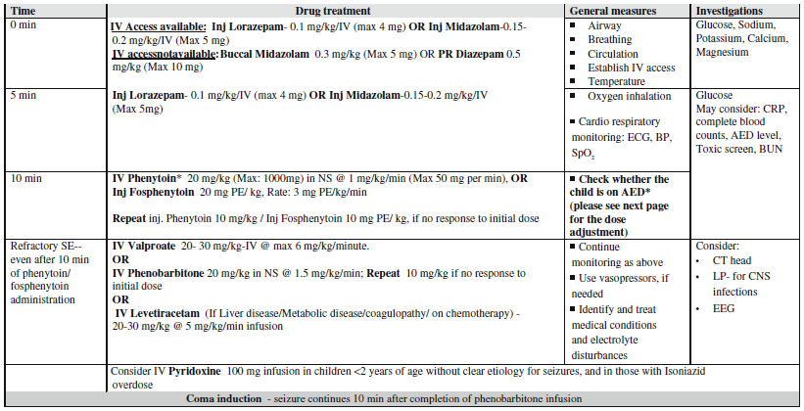
Status epilepticus algorhithm of treatment

Slide 41
Febrile convulsions
2-5% of children
Period 3 months to 5 years
During a sudden rise in temperature early in the course of illnes
in the absence of intracranial infection

