Slide 1
X-ray skull
X - ray of the bones
A-P, lateral view
Stenvers – meatus acusticus internus
Axial view – basis of the skull
Brain and blood are not visible

Slide 2
X-ray skull
Indications
Head injury
Headache
Unconsciousness
Today is used less frequently

Slide 3
X-ray skull

Slide 4
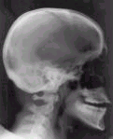
X-ray skull

Slide 5
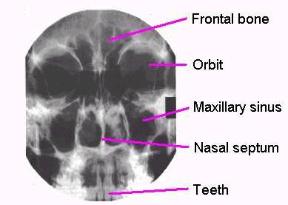
Plazmocythoma

Slide 6
X-ray - skull - axial projection

Slide 7
Spinal column X – ray
X - ray of the bones
A-P, lateral view
Foramina intervertebralia – under 45 degree

Slide 8
Spinal column X – ray
Indications
Back pain
Spinal column injury
Radiculopaties
We cannot see spinal column or intervetebral discs
Today is used less frequently

Slide 9
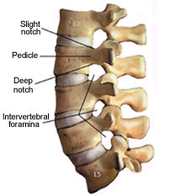
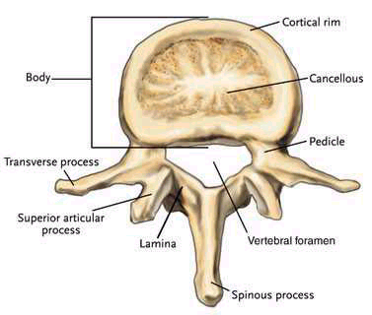
Spinal column - anatomy

Slide 10
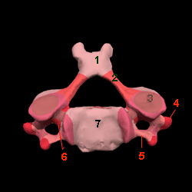
Vertebres - pedicles

Slide 11
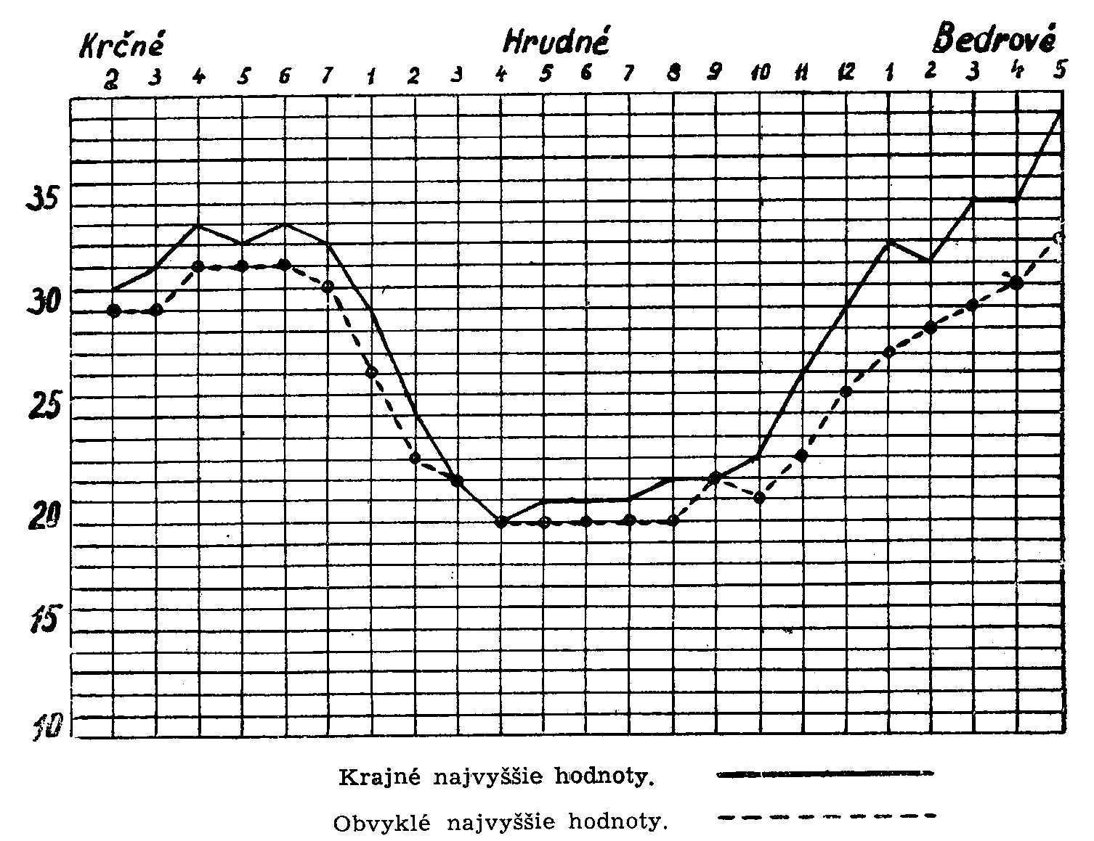
Interpedicular distance
cervical
thoracal
lumbal
mm

Slide 12
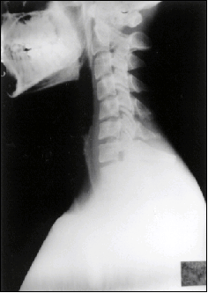
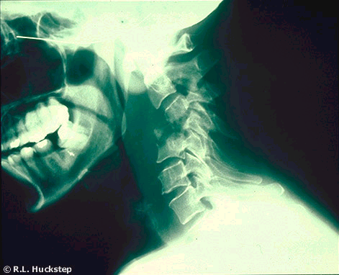
X-ray - spinal column

Slide 13
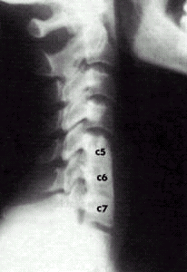
X-ray - spinal column

Slide 14
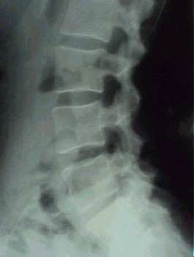
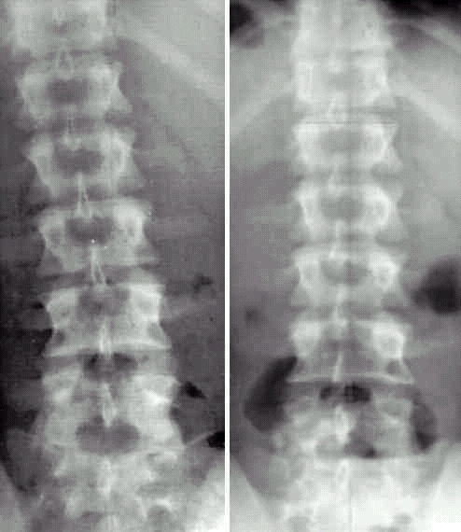
X-ray - spinal column

Slide 15
Computerized tomography
Tomography (tomos = slice, graphein = write)
Method which generate three-dimensional image of the inside of an object from a large series of two-dimensional X-ray images taken around a single axis of rotation.
Visualization of intracranial (brain) structures (from 1970s) in the scale of the grey colours
Allan M: Cormack and Godfrey N. Hounsfield – Nobel Prize in Physiology and medicine in 1979

Slide 16
Computerized tomography
Tightly collimated X-ray beam is directed through the patient.
It produce a volume of data which can be manipulated, through a process known as windowing, in order to demonstrate various structure based on their ability to block the X-ray beam.
During the scanning the X-ray beam travels in a circular path around the patient.

Slide 17
Computerized tomography
Detectors mesure x-ray attenuation, the signal from the radiation detector is digitized by conventer to the images.
Images are reconstructed with air seen as black and bone as white.
Density of brain tissue is measured in the Hounsfield units (HU)
Air - tissue with the least attenuation of x-rays and on Hounsfield scale is designated as - 1000 HU (black)
Bone – the gratest attenuator is designated as +1000 HU (white)
Structures with higher density than CSF are on the brain CT white and grey
Water – 0 HU

Slide 18
Appearance of Tissues on CT
Appearance of Tissues on CT
Tissue | Hounsfield Unit | Gray scale
Air | -1000 | Black (↓↓↓)
Fat | -100 | Black (↓↓)
Cerebrospinal fluid | 0 | Black (↓)
Brain | 30 | Gray ( - )
Extravasated blood | 100 | White (↑↑)
Contrast medium enhancement | 100 | White (↑↑)
Bone | 1000 | White (↑↑↑)
↓↓↓, marked hypoattenuation; ↓↓, moderate hypoattenuation; ↓, mild hypoattenuation;
-, isoattenuation; ↑↑, moderate hyperattenuation; ↑↑↑, marked hypoattenuation

Slide 19
Spinal column CT
Indication
Back pain
Spinal column injury
Radiculopaties

Slide 20
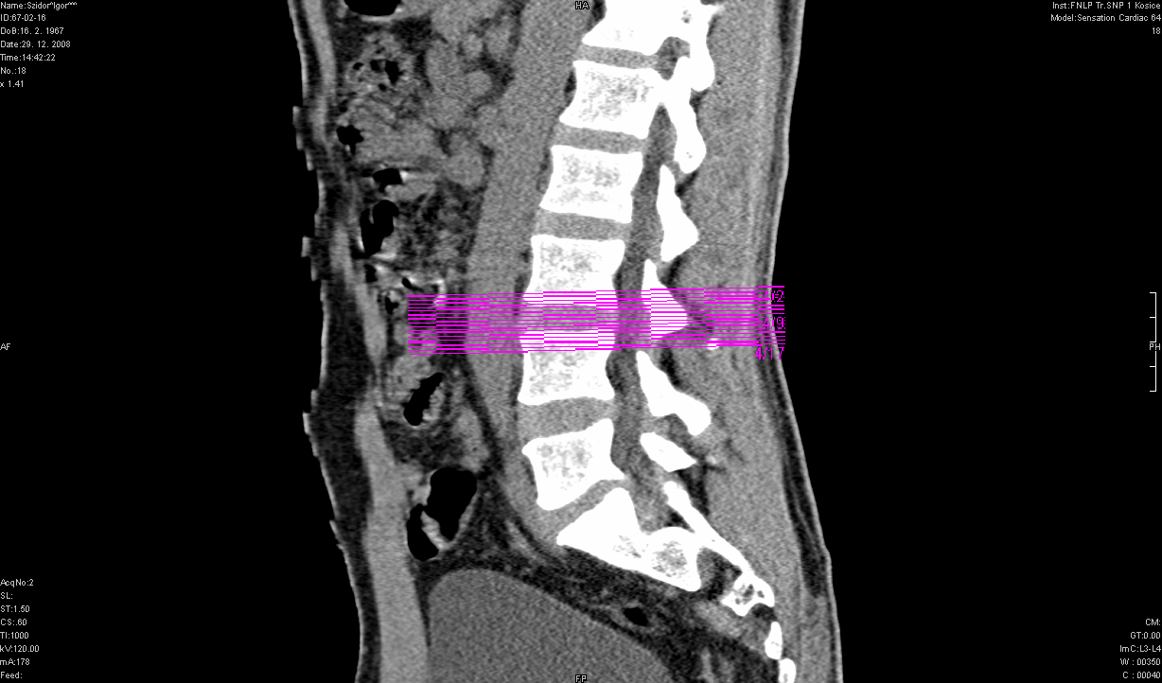
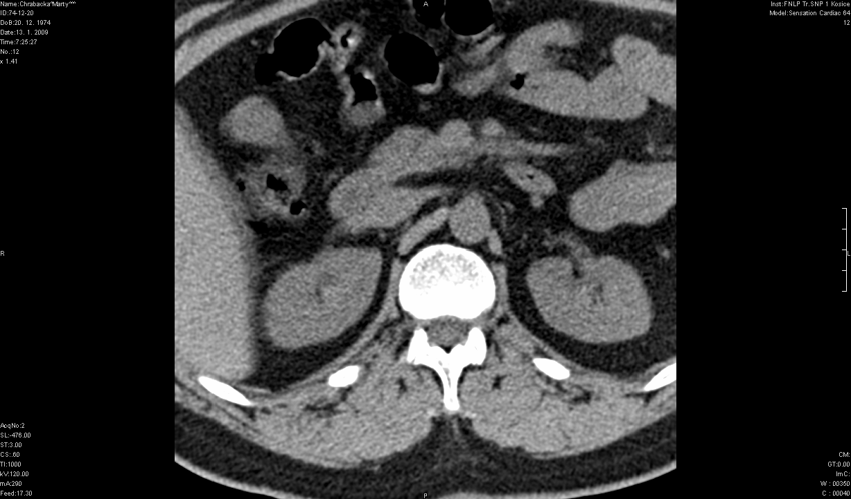
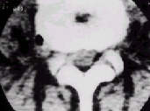
Spinal column CT

Slide 21
Brain CT
Brain in the scale of grey colour
Indications
Strokes – the first choice for diagnostics
Brain tumors
Headache
Susp. AVM
Neuroinfections
Head injury
Dementia

Slide 22
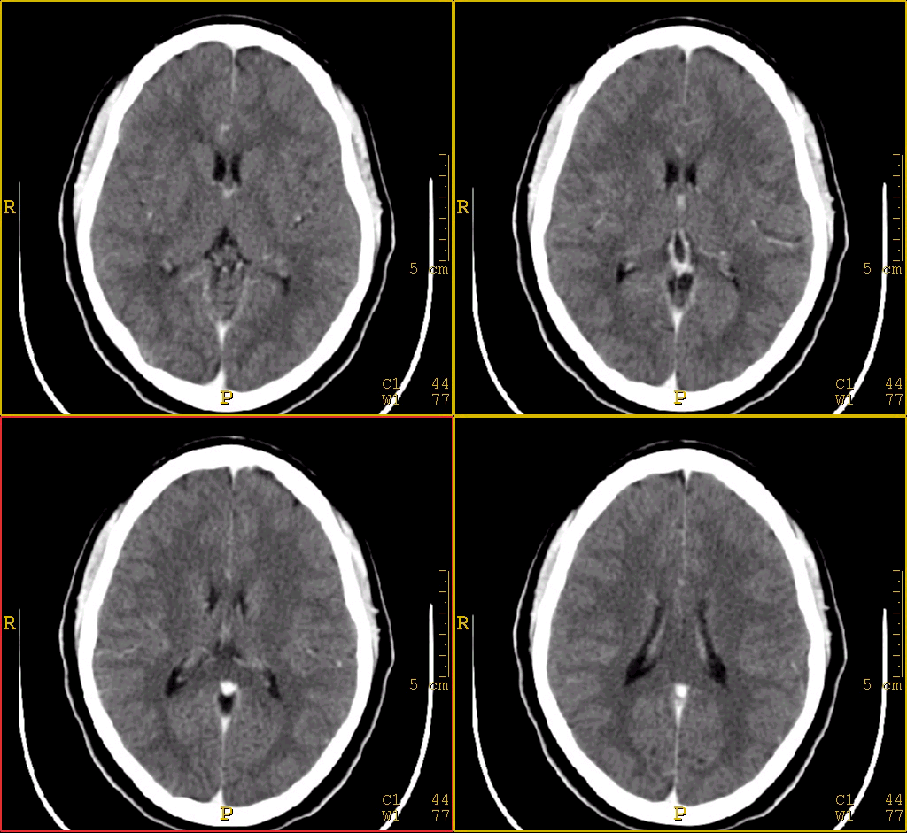
Brain CT

Slide 23
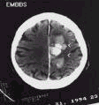
Brain CT
Brain infarct
lower density - white
Brain haemorrhage
higher density - white

Slide 24
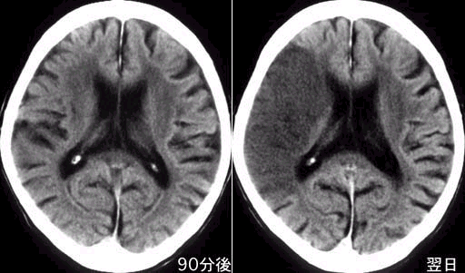
CT - brain infarct

Slide 25
Magnetic resonance imaging – MRI
MRI using nonionizing energy provides better resolution of different structures within the brain and spinal cord.
Basic principle: placing the patient within a powerful magnetic field, which causes the protons of tissues and fluids to align themselves in the orientation of the magnetic field.
The images generated by the MRI machines are truly remarkable with high degree of contrast between gray and white matter.

Slide 26
Spinal column MRI
Indications
Multiple sclerosis – first choice for diagnosis
Spinal canal diseases
Radiculopaties
Spinal cord tumors
Spinal canal injury
Spinal cord vessels diseases

Slide 27
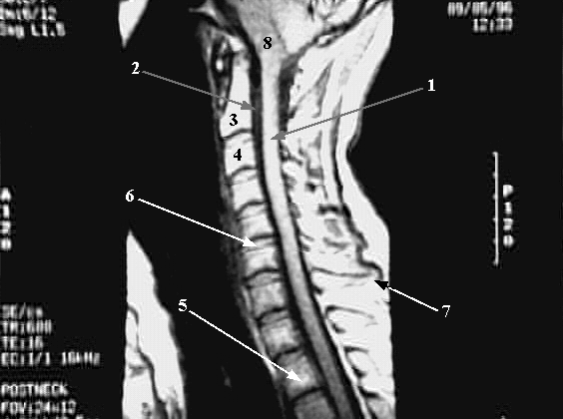
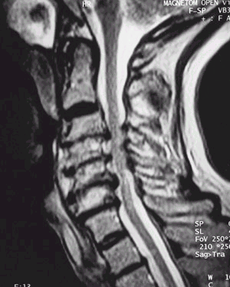
MRI – spinal column

Slide 28
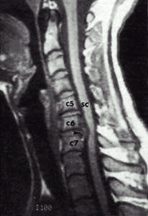
MRI – spinal column

Slide 29
Brain MRI
Scans are in grey scale of colours
Light subjects - hyperintensity
Darker – hypointensity

Slide 30
T1, T2 weighted MRI
To differ the tissues – they should have different signal
There are two types of magnetization:
Transverzal - T2 weighted picture
Longitudinal - T1 weighted picture.

Slide 31
T1, T2 weighted MRI
T1 – brain cortex – darker than white matter, CSF- dark
T2 brain cortex lighter than white matter, CSF – white.

Slide 32
FLAIR MRI
Supression of CSF
Demyelinating lesions in white matter
FLAIR („fluid-attenuated inversion recovery“)
Demyelinating lesions – the most often cause by multiple sclerosis

Slide 33
DWI MRI, ADC maps
Diffusion weighted imaging (DWI) is a form of MR imaging based upon measuring the random Brownian motion of water molecules within a voxel of tissue, and is particularly useful in cerebral ischaemia and tumour characterisation.
DWI – water restriction

Slide 34
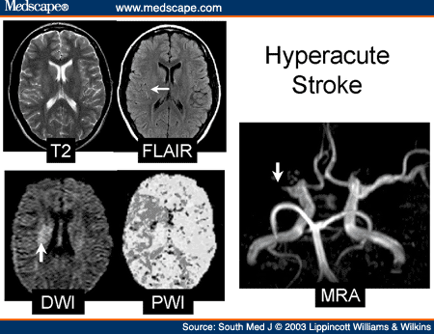

Slide 35
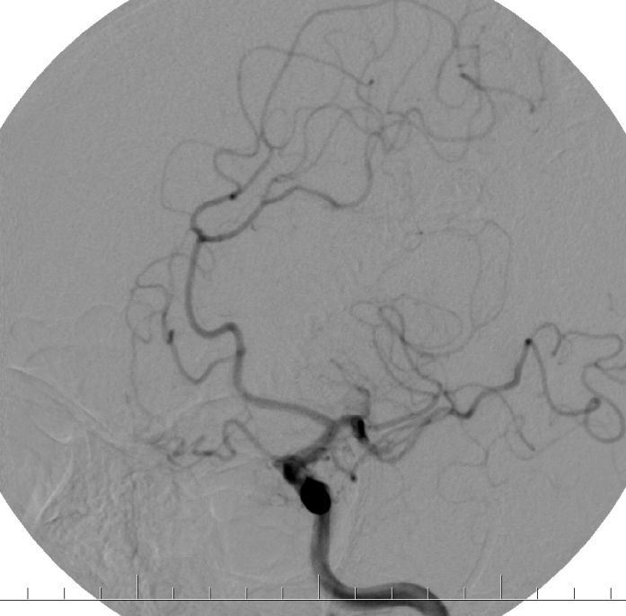
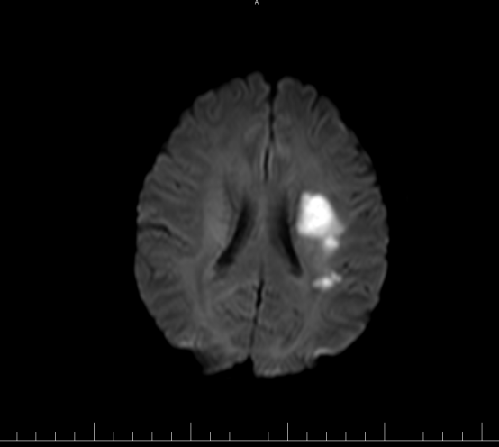
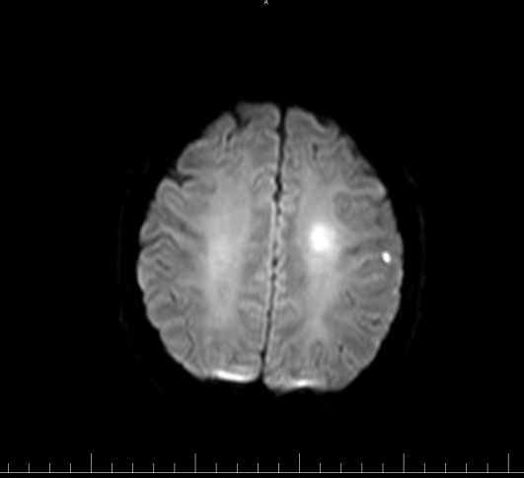
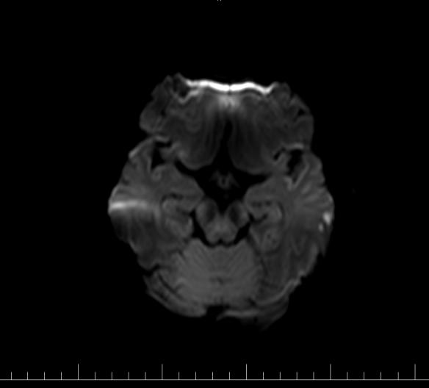
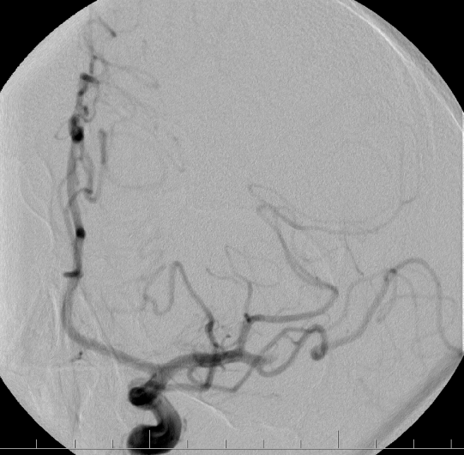
42-years old patient after TIA
DWI MRI
DWI MRI
DWI MRI
Patient after TIA after 3 hours had aphasia
Brain infarct (DWI)
Occlusion of M2 MCA l.sin
Archív Neurologickej kliniky UNLP a LF UPJŠ Košice

Slide 36
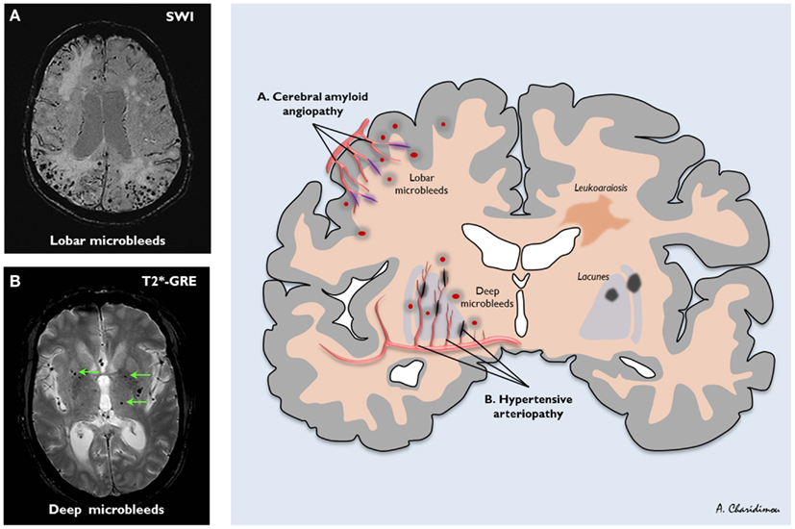
MRI – SWI, T2*- GRE
Diagnosis os amyloid angiopathy, microbleeds

Slide 37
Indications for MRI :
multiple sclerosis – firsts choice
suspected tumors, especially in fossa posterior and spinal cord
ischemic vascular disease
athrophic diseases
inflammatory spinal and cerebral processes
subcortical and periventricular lesions
tissue malformations
cortical dysplasias.

Slide 38
MRI
MRI of the spine provides clear images of the spinal cord and cauda equina, intervertebral discs, vertebral bodies, spinal tumors, syringomyelia etc.
The administration of intravenous contrast material – gadolinium, permits even sharper definition of lesions (enhancement).
The main dangers in the use of MRI are ferromagnetic objects. Cardiac pacemarker is an absolute contraindication to the use of MRI.
MR-AG
Functional MRI (fMRI), can show cerebral metabolism and blood flow.

Slide 39
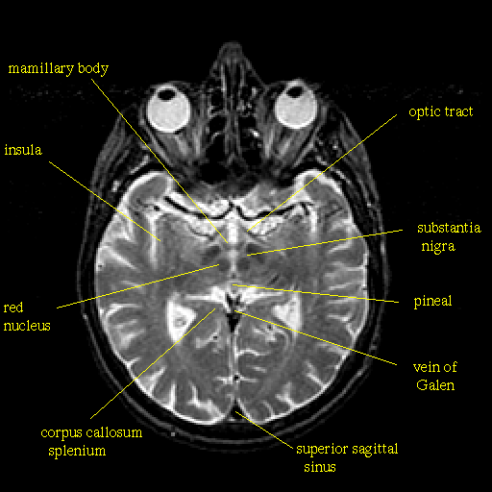

Slide 40
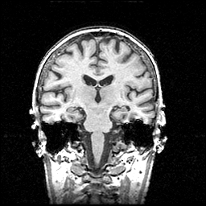
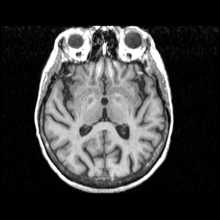

Slide 41
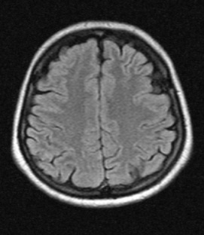
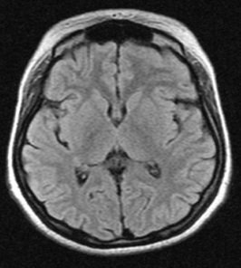
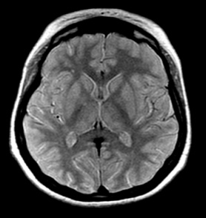
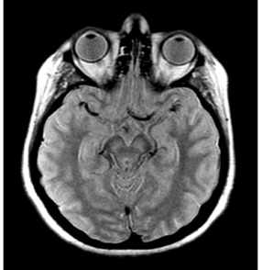
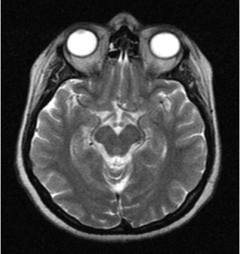
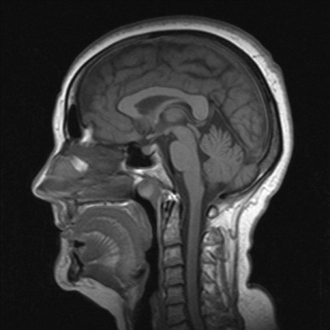
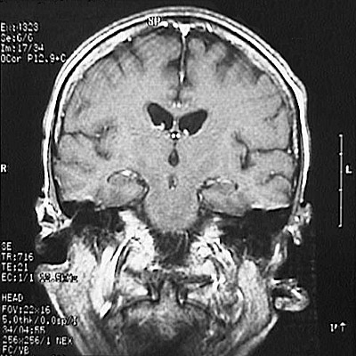
Brain MRI
Axial MR scan
Sagital MR scan
Coronal MR scan

Slide 42
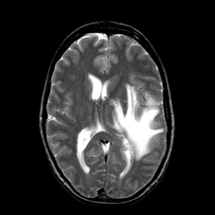
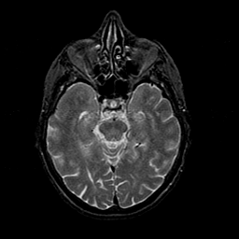
Glioblastoma Multiple small infarcts

Slide 43
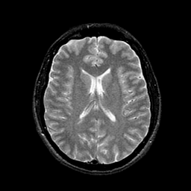
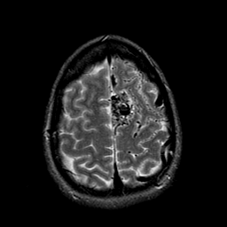
AIDS- frontal hypoperfusion AV malformation

Slide 44
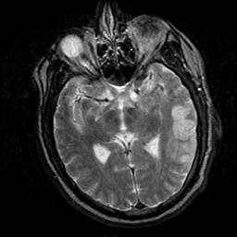
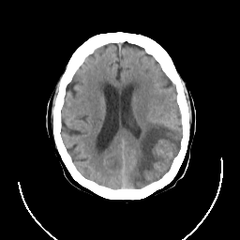
Left HMS, cortical Left HMS, cortical a
Ischemia, fluent aphasia ischemia, aphasia

Slide 45
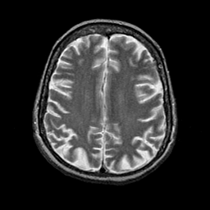
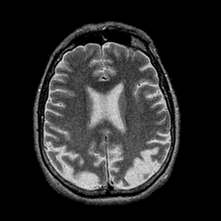
Alzheimer disease, cortical atrophy

Slide 46
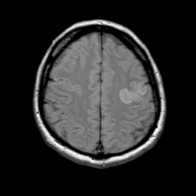
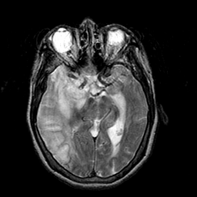
Ischemic stroke, left HMS Fatal large ischemia,
right HMS

Slide 47
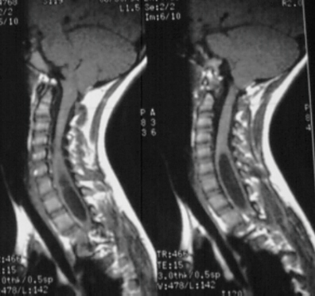
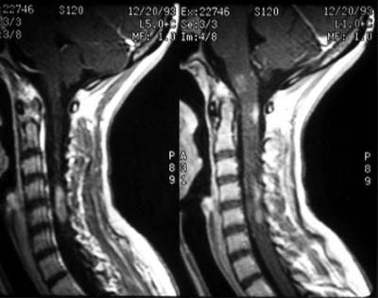
Cervical spinal cord MRI
syringomyelia multiple demyelinative lesions

Slide 48
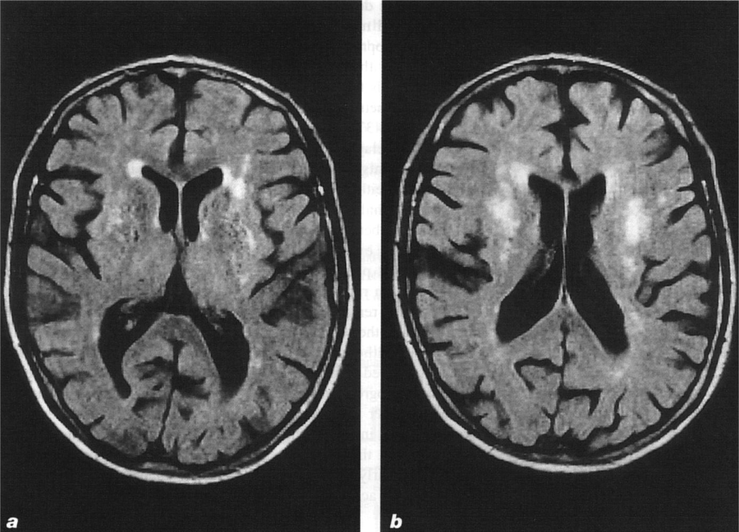
MS, FLAIR sequency

Slide 49
Anatomy of cerebral circulation

Slide 50
Anatomy

Slide 51
Ultrasound
Visualisation of subcutaneous body structures – vessels, muscles, tendoms, internal organs
Ultrasound – all acustis energy with a frequency above human hearing (20000 Hertz or 20 kHz).
Sonographic scanners – use frequency in range 2-18 megaHertz
Principle – sound waves bounce off of different tissues (blood vessels) or moving objects – red blood cells.

Slide 52
B-scan (mode) of carotid bifurcation
B-mode – show structures under the probe uses the principle of
refraction and reflection of ultrasonic waves when passing through
various echogenic enviornments

Slide 53
B-scan (mode) of carotid bifurcation atherosclerotic plaque

Slide 54
B-scan (mode) with colour of carotid bifurcation

Slide 55
B-scan (mode) - carotid bifurcation – occlusion of ICA

Slide 56
B-scan carotid bifurcation high grade stenosis

Slide 57
Doppler imaging (ultrasound)
Based on the magnitude (size) of the change in the frequency of the ultrasonic waves reflected from the moving particle (erythrocytes), the velocity of the moving particles is determined

Slide 58
Duplex ultrasound B-scan + Doppler
Duplex ultrasound – uses B-mode and Doppler mode
for display of blood vessels

Slide 59
Doppler imaging (ultrasound)
Based on the magnitude (size) of the change in the frequency of the ultrasonic waves reflected from the moving particle (erythrocytes), the velocity of the moving particles is determined

Slide 60
Doppler imaging (ultrasound)
Based on the magnitude (size) of the change in the frequency of the ultrasonic waves reflected from the moving particle (erythrocytes), the velocity of the moving particles is determined

Slide 61
Doppler effect
The Doppler effect (or the Doppler shift) is the change in frequency of wavelnegth of a wave for an observer who is moving relative to the wave source.
It is named after the Austrian physicist Christian Doppler, who described the phenomenon in 1842.

Slide 62
Doppler effect
The reason for the Doppler effect is that when the source of the waves is moving towards the observer, each successive wave crest is emitted from a position closer to the observer than the previous wave. Therefore, each wave takes slightly less time to reach the observer than the previous wave.
Hence, the time between the arrival of successive wave crests at the observer is reduced, causing an increase in the frequency.

Slide 63
Doppler effect
In cerebral vessels if the blood moves toward the probe, the frequency of the reflected waves increases
Conversely, if the source of waves is moving away from the observer, each wave is emitted from a position farther from the observer than the previous wave, so the arrival time between successive waves is increased, reducing the frequency.
In cerebral vessels if the blood moves away from the probe, the frequency of the reflected waves decreases

Slide 64
Duplex ultrasound examination of extracranial arteries
We examine only extracranial part of cerebral arteries
Indications
Ischemic stroke and other cerebrovascular diseases
Control after carotid surgery (carotid endarterectomy)
Control after carotid stenting

Slide 65
Duplex ultrasound examination of extracranial arteries
Carotid siphone – is localised intracranially
We cannot examine it by extracranial Duplex

Slide 66
TABLE 14 INTERNAL CAROTID STENOSIS
Stenosis % | Peak Systolic Velocity | Blod flow | End Diastolic Velocity
≤ 50% | ≤ 120 cm/s | Laminar | ≤ 90 cm/s
51-70% | 120-140 cm/s | Turbulent | ≤ 90 cm/s
71-95% | ≥ 240 cm/s | Turbulent | ≥ 90 cm/s
96-99% | ≤ 120 cm/s | Turbulent | ≤ 90 cm/s
Occlusion | - |  | -

Slide 67
Table 15 INTERNAL CAROTID STENOSIS CLASSIFICATION
Classification according haemodynamics | Classification according degree of stenosis | Classification according % reduction of lumen
Haemodynamics is not influenced | Light stenosis | ≤ 50%
Influenced haemodynamics | Mild stenosis | 51-70%
 | Moderate stenosis | 71-95%
 | Severe stenosis | 96-99%
Occlusion | Occlusion | Occlusion

Slide 68
Transcranial doppler - TCD
Noninvasive method for the examination of intracranial vessels
Examination through the temporal bone acoustic window

Slide 69
Transcranial ultrasound

Slide 70
TABLE 16 IDENTIFICATION OF INTRACRANIAL ARTERIES
Artery | Transducer position | Depth of sample volume (mm) | Direction of flow
MCA | transtemporal | 30-60 | Toward
ACA/MCA bifurcation | Transtemporal | 55-65 | Bidirectional
ACA | Transtemporal | 60-80 | Away
PCA (P1) | Transtemporal | 60-70 | Toward
PCA (P2) | Transtemporal | 60-70 | Away
ICA | Transtemporal | 55-60 | Toward
OA | Transorbital | 40-60 | Toward
VA | Transforaminal | 60-90 | Away
BA | Transforaminal | 80-120 | Away

Slide 71
Transcranial ultrasound
Indications
Strokes
Subarachnoid haemorrhage
Brain death

Slide 72
Angiography

Slide 73
Angiography

Slide 74
Angiography

Slide 75
Digital subtraction angiography

Slide 76
3D CT angiography

Slide 77
3D CT angiography

Slide 78
3D CT angiography

Slide 79
SPECT – single photon emission computed tomography
Functional nuclear imaging technique performed to evaluate regional cerebral perfusion.
Cerebral blood flow is closely linked to neuronal activity, the activity distribution is presumed to reflect neuronal activity levels in different areas of the brain.
A lipophilic, PH-neutral radiopharmaceutical (most commonly^{99m} Tc-hexamethylpropyleneamine oxime [HMPAO] and^{99m} Tc-ethylene cysteine diethylester [ECD], with a half-life of 6.02 hours) is injected into the patient, which crosses the blood-brain barrier and continues to emit gamma rays.
A 3-dimensional representation of cerebral blood flow can be registered using gamma detectors, allowing for interpretation.

Slide 80
SPECT – single photon emission computed tomography
Measurment of brain function after application of radioisotopes

Slide 81
SPECT - kamera

Slide 82
SPECT
Indications
Strokes
Dementia
Parkinson disease
Epilepsy
Brain tumors

Slide 83
SPECT

Slide 84
SPECT – brain tumor
MR – T2
MR – gad
Thalium SPECT
SPECT

Slide 85
DaT SCAN
The dopamine transporter, or DaT, scan uses a chemical that labels the dopamine transporter in the area of the brain known as the striatum.
The dopamine transporter, which moves dopamine in and out of cells, is decreased in the striatum in persons with Parkinson’s disease and related disorders.
DaT scans are not able to distinguish between
idiopathic Parkinson’s disease and atypical parkinsonian syndromes
progressive supranuclear palsy, multiple system atrophy, and cortical basal degeneration.

Slide 86
DaT SCAN
Disease | Decreased DT | Decreased D2 (IBZM)
Parkinson disease | YES | NO
Multisystem atrophy | YES | YES
Progressive supranuclear palsy | YES | YES
Esential tremor | NO | Probably NO
Vascular parkinsonism | NO | Probably YES
Alzheimer disease | NO | Probably NO
Lewy body dementia | YES | YES

Slide 87
DaT SCAN

Slide 88
DaT SCAN

Slide 89
DaT SCAN

Slide 91
DaT SCAN

Slide 92
DaT SCAN

Slide 93
Positron emission tomography - PET
Nuclear medicine, functional imaging technique used to observe metabolic processes in the body, including brain.
The system detects pairs of gamma rays emitted indirectly by a positron -emitting radionuclid (tracer), which is introduced into the body on a biologically active molecule.
Three-dimensional images of tracer concentration within the body are then constructed by computer analysis.

Slide 94
Positron emission tomography - PET
In modern PET-CT scanners, three dimensional imaging is often accomplished with the aid of a CT X-ray scan performed on the patient during the same session, in the same machine.
The most often the biologically active molecule chosen for PET is fludeoxyglucose (FDG), an analogue of glucose.
The concentrations of tracer imaged will indicate tissue metabolic activity as it corresponds to the regional glucose uptake.

Slide 95
Positron emission tomography - PET
PET radioisotopes
Labelling agent | Half-life
carbon-11 | 20.3 minutes
oxygen-15 | 2.03 minutes
fluorine-18 | 109.8 minutes
bromine-75 | 98.0 minutes

Slide 96
PET - Astrocytoma

Slide 97
PET – Alzheimer disease

Slide 98
PET-CT (Positron Emission Tomography with Computed Tomography)

