Slide 1
Andrology
Prof. MUDr. Vincent Nagy, PhD., MPH.
Head, Department of Urology
Medical School,
PJ. Šafárik University , Košice, Slovakia

Slide 2
Andrology is
Subspeciality of Urology and deals with:
Male infertility
Erectile dysfunction (ED)
Penile and testicular diseases

Slide 3
Erectile dysfunction (ED)
Definition:
Inability to attain and mantain an erection sufficient to permit satisfactory sexual performance

Slide 4
Epidemiology
Current epidemiology on erectile dysfunction (ED) suggests that approximately 5-20% of men have moderate-to-severe ED.
Different definitions of ED, age distributions and concomitant medical conditions, as well as methodological differences, may explain much of the variance in reported prevalence rates.
Various chronic disorders are associated with elevated rates of ED including depression, diabetes, and cardiovascular and neurological diseases.

Slide 5
Epidemiology
Such disorders are more common in the elderly, which may partially explain the elevated prevalence of ED in men over 60 y of age.
Currently, up to 70% of men with ED are not treated.
However, so many men experience considerable distress from their condition, that the increasing awareness of ED as well as the availability of noninvasive treatments may result in a greater proportion of patients seeking treatment, and eventually regaining satisfaction with their sex life.

Slide 6
Physiology of erection
Complex neurovascular phenomen
Principally – haemodynamic chnages in the cavernous bodies
Increase of arterial inflow
Relaxation of their cavernous tissue
Decrease venous outflow
neurophysiology of erection
Principle neurotransmitter-nitride oxide (NO)
Others: acetylcholine, VIP, pG E1

Slide 7
Etiology of ED
Organic (70%):
Vascular
Neurological (SM, spinal cord injury)
Psychogenic (10%)
Mixed (20%)

Slide 8
Risk factors of organic ER
Erectile dysfunction is strongly related to both physical and psychological health. Among the major risk factors are
Diabetes mellitus (50%)
Atherosclerosis (40%)
Heart disease,
Arterial Hypertension
and decreased HDL levels.

Slide 9
Risk factors of organic ER
Medications for diabetes, hypertension, cardiovascular disease and depression may also cause erectile difficulties.
In addition, there is a higher prevalence of erectile dysfunction among men who have undergone radiation or surgery for prostate cancer,
or who have a lower spinal cord injury
or other neurological diseases (e.g. Parkinson’s disease, multiple sclerosis).
Life style factors,
including smoking,
alcohol consumption and sedentary behavior are additional risk factors.

Slide 10
Diagnosis
History
Physical examination
Laboratory tests (blood, biochemistry, hormones)
Intracavernous vasoactive drug injection (PgE1)
Duplex USG,
Doppler sonography
Arteriography
Cavernosography, cavernosometry
Neurologic,
psychodiagnostic evaluation

Slide 11
Treatment - First line therapy
1) Oral therapy:
2) Vacuum device
Selective inhibitors of PDE 5:
Sildenafil: works 4-5 hours
CI: concomitant nitrate therapy
60-80%effectivity
Vardenafil
Tadalafil (Cialis):
Works 24-36 hours
90% effectivity
30 min rigid erection
3) psychosexual therapy

Slide 12
Treatment - second line therapy
1) Intracavernosal injection
2) Intraurethral therapy
Pg E1, Papaverin, Phentolamin, Vasoactive intestinal peptide (VIP)
Effective in 60-90% of the cases
CI: hypersensitivity to the drug
Men at risk for priapism
Side effects: prolonged erection or priapism
Penile pain and penile fibrosis
Pg E1 (semi-solid pellet)
Effective in 70% of cases
Side effect- pain

Slide 13
Third line therapy
Prosthesis
Surgical therapy
Malleable
Inflatable:
More satisfying
Mechanical failure
More expensive
Complications:
Infection
erosions
Arterial surgery
Venous surgery

Slide 14
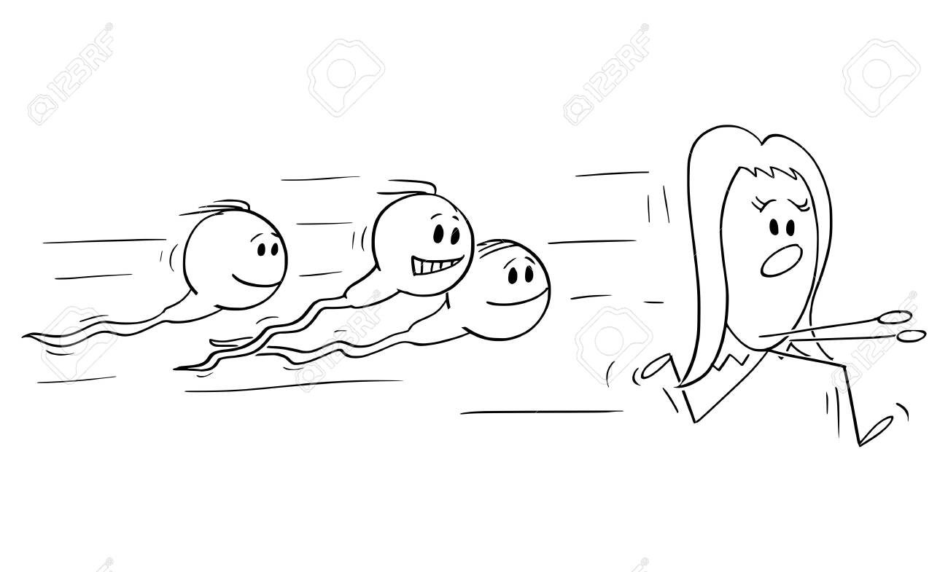
Male infertility
Male infertility refers to a male's inability to cause pregnancy in a fertile female.
In humans it accounts for 40–50% of infertility
It affects approximately 7% of all men
Male infertility is commonly due to deficiencies in the semen, and semen quality is used as a surrogate measure of male fecundity
In general 15% of couples infertile
50% of them because of male

Slide 15
Etiology
Pre-testicular
Testicular
Hypogonadotropism
(congenital)
(aquired)
Hormonal dysbalance
Chromosomal disorders
Varicocele (15%)
Cryptorchidism
Orchitis
Drugs
Irradiation
Aging

Slide 16
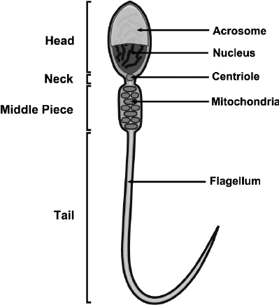
Etiology
Post-testicular
Schematic diagram of the structure of mammalian sperm.
Blockage of ducts leading away from testes
Impaired sperm motility

Slide 17
Immune infertility
Antisperm antibodies (ASA) have been considered as infertility cause in around 10–30% of infertile couples.
ASA production are directed against surface antigens on sperm,
which can interfere with sperm motility and transport through the female reproductive tract,
inhibiting capacitation and acrosome reaction,
impaired fertilization,
influence on the implantation process,
and impaired growth and development of the embryo.

Slide 18
Immune infertility
Risk factors for the formation of antisperm antibodies in men include
the breakdown of the blood‑testis barrier,
trauma and surgery,
orchitis,
varicocele,
infections,
prostatitis,
testicular cancer,
failure of immunosuppression
and unprotected receptive anal or oral sex with men

Slide 19
Diagnosis
History
Physical examination
Semen analysis
Hormonal profile (LH, FSH, Testosteron, Prolactin)
Microbiological examinatin (Chlamydias, Mycoplasmas, Ureaplasmas,HPV )
Genetic screening
Imagine methods (USG, TRUS, Doppler)

Slide 20
Semen analysis
Volume more than 2 ml
pH 7,2 – 8,0
Sperm concentration more than 20mil/ml
Motility more than 50% forward progression
Morphology more than 30% with normal forms
Vitality more than 75% live
Optional tests – post coital test
Antisperm antibodies

Slide 21
Some names used in andrology
Normozoospermia – normal finding
Oligozoospermia – low sperm concentration
Astenozoospermia – low motility
Teratozoospermia – patological forms prevalence
Necrotoospermia – non vital sperm only
Azoospermia – no sperm
Hypospermia – low volume of ejaculate
Aspermia – no ejaculate

Slide 22
Therapy
Pharmacological – causal or empirical
Surgical – varicocele ligation, anastomotic procedur, TUR of verum montanum etc.
Prophylaxis –orchidopexy, early intervention in testicular torsion

Slide 23
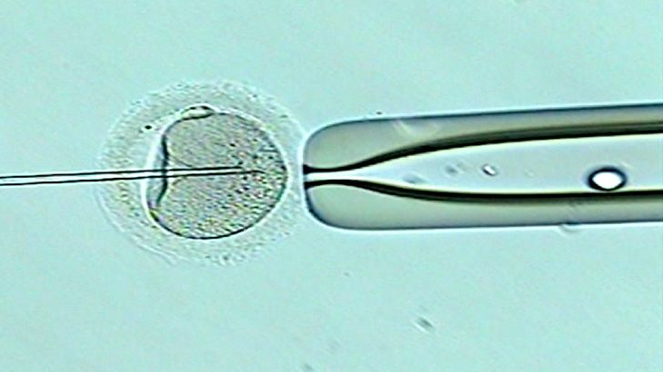
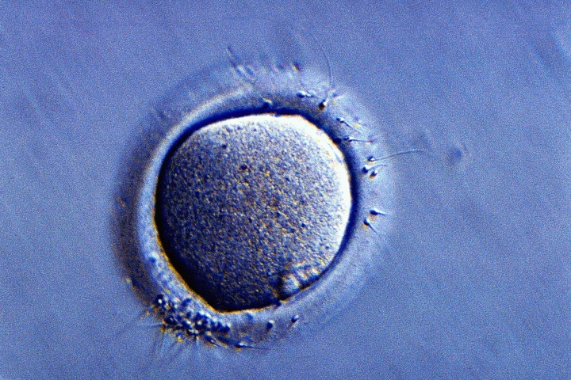
Assisted conception
The preferred methods of treatment at present:
Intrauterine insemination
In vitro fertilisation methods (IVF)
ICSI (intracytoplasmic sperm injection)-the sperm directly into the egg
the most effective method known

Slide 24
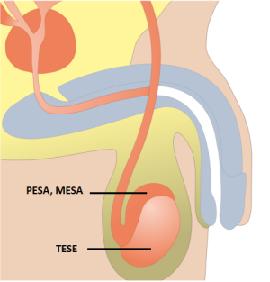
Assisted conception
Surgical sperm retrieval techniques used when obstruction is the problem
MESA (Micro Epididymal Sperm Aspiration)
TESE (Testicular Sperm Extraction)
PESA (Percutaneous Epididymal Sperm Aspiration)
Perc biopsy: percutaneous biopsy of the testis.
Surgical sperm retrieval techniques when there is no obstruction
Microdissection TESE - a microdissecting microscope
is used to pinpoint the tissue to be removed

Slide 25
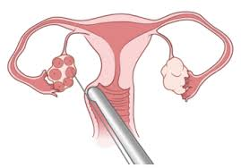

Egg harvesting and sperm collection

Slide 26
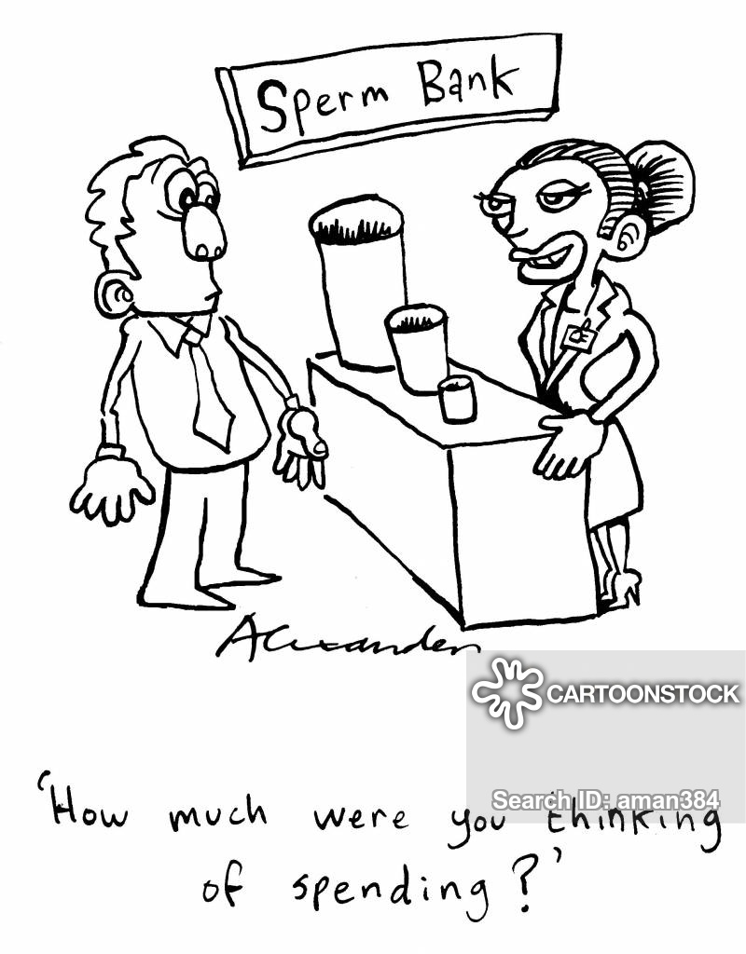
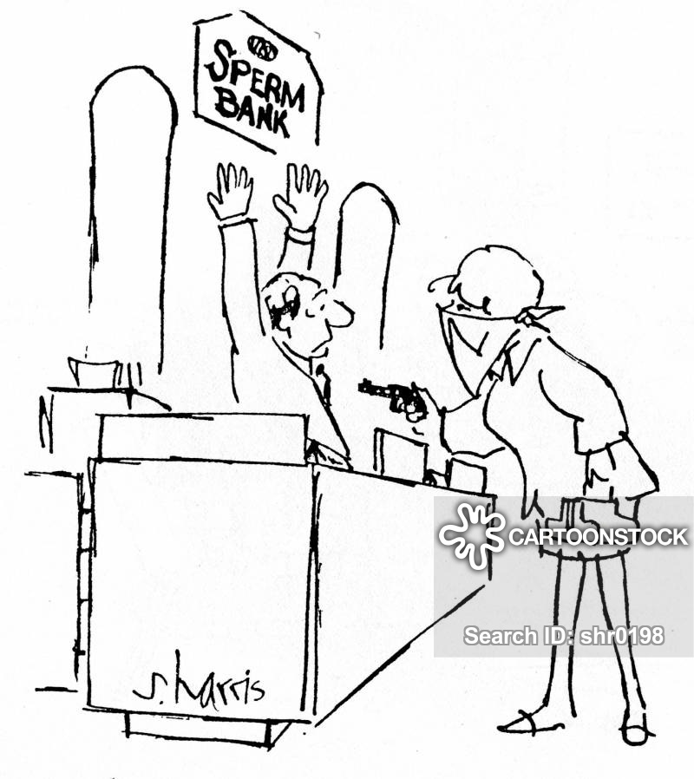
Thank you for attention

